Slide 1





DEPRECIATION OF ASSETS
LC ACCOUNTING | MR. REGAN

Slide 2

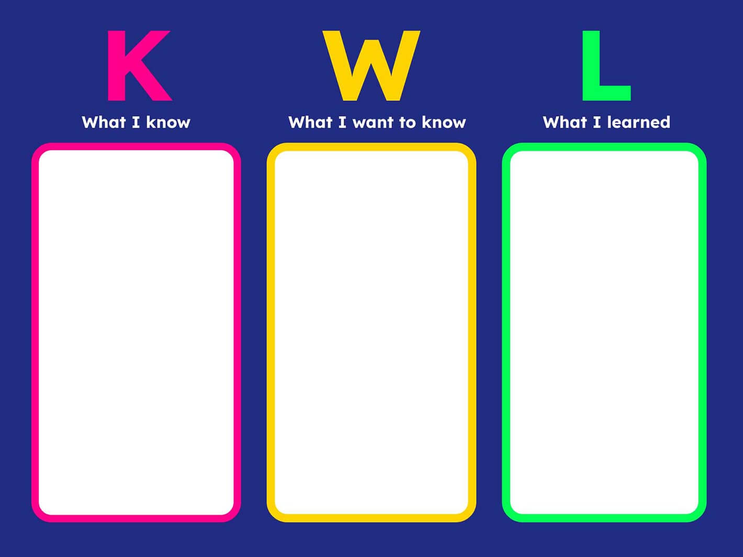
Draw and Fill in a KWL Chart in your Copy
Retrieval Practice Activity:

Slide 3



TODAY’S
LEARNING INTENTIONS:
Define Depreciation
Identify Causes of Depreciation
Define Useful Economic Life
List the 2 Methods of Depreciation

Slide 4


DEFINITION:
The measure of the loss in value of a fixed asset over its useful economic life.

Slide 5


How is this loss in value Recorded in Accounts?
Profit & Loss a/c:
Selling & Distribution Expense
Balance Sheet:
- Accumulated Depreciation:
Calculating Current Value (NBV)

Slide 6
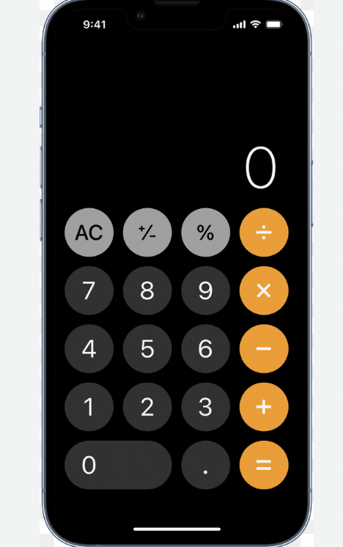
How is Depreciation Calculated?
We Consider:
The Cost of the fixed Asset
The Estimated Life of an Asset
The estimated Scrap Value of the Asset
The appropriate method used (based on policy)
The type of fixed asset

Slide 7
So…
Cost – Depreciation + Scrap Value = Net Book value of an Asset

Slide 8

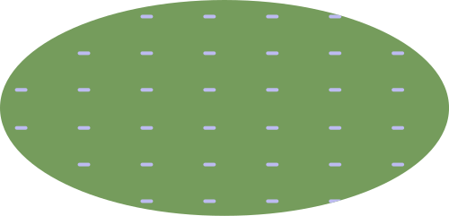

CAUSES OF DEPRECIATION
  Causes of Depreciation include:
Obsolescence (becoming outdated)
End of its useful economic life
Natural usage (wear and tear)

Slide 9

MUDDY PUDDLES
ANYTHING ABOUT THE DEFINITION AND CAUSES OF DEPRECIATION THAT YOU ARE UNSURE OF?

Slide 10
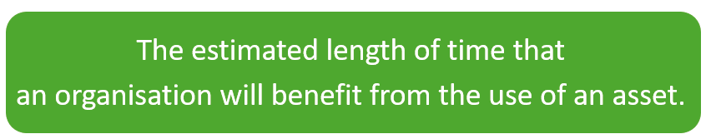
USEFUL ECONOMIC LIFE

Slide 11
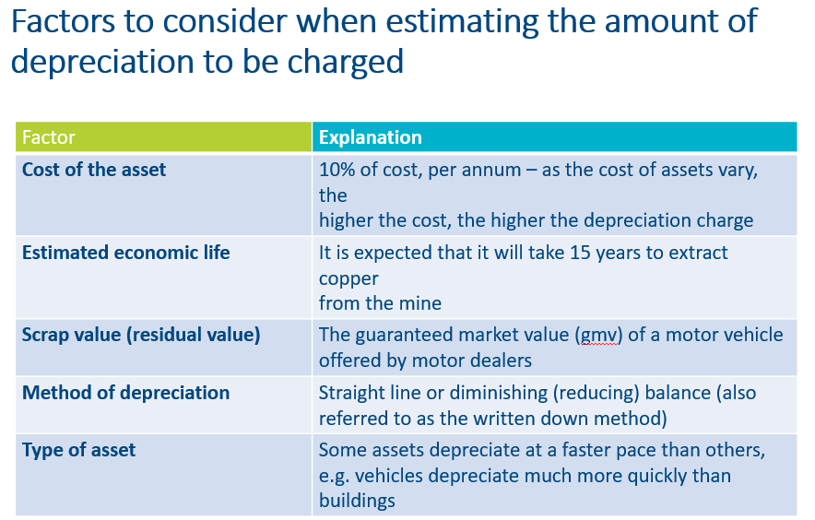
CALCULATING DEPRECIATION

Slide 12

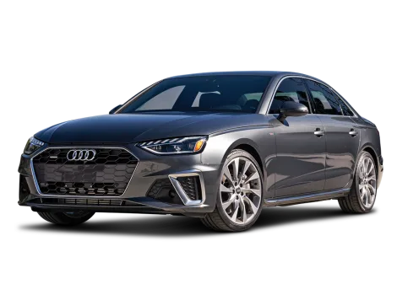
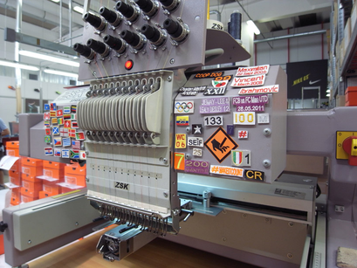
PRODUCT EXAMPLES:
iPhone 13
2024 Audi A4
Factory Machinery

Slide 13



METHODS OF DEPRECIATION
1.Straight line method
  2.Reducing balance method

Slide 14
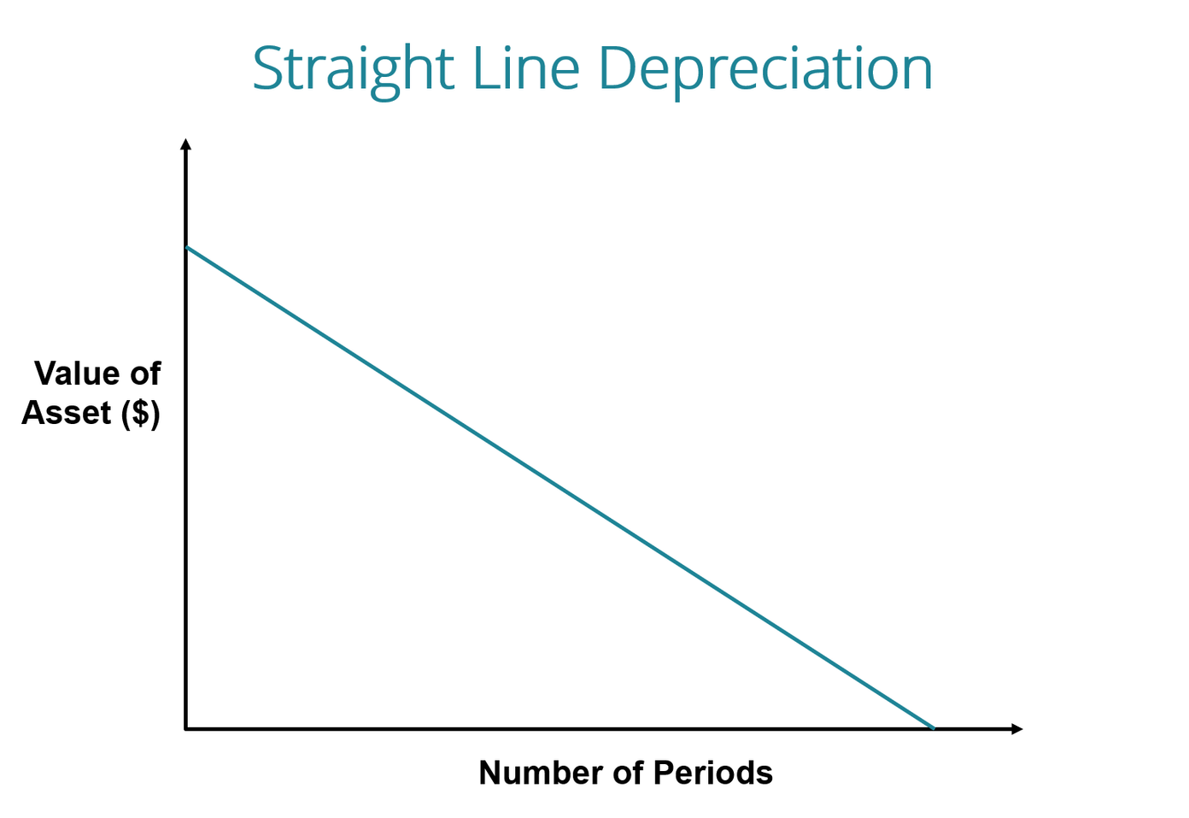
STRAIGHT-LINE DEPRECIATION
THE SAME AMOUNT OF THE COST OF THE ASSET IS WRITTEN OFF EACH YEAR.
E.G. 10% OF THE COST PRICE.

Slide 15
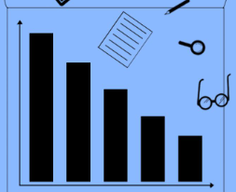
REDUCING BALANCE DEPRECIATION
A CONSTANT PERCENTAGE IS APPLIED TO A GRADUALLY REDUCING VALUE OF THE ASSET.
E.G. 10% OF ITS VALUE EVERY YEAR

Slide 16

SCRAP VALUE
AN ASSET MAY HAVE A RESIDUAL/SCRAP VALUE AT THE END OF ITS USEFUL ECONOMIC LIFE.
EXAMPLE?

Slide 17
Recap Activity:
Key Word Bingo

Slide 18
DEPRECIATION OF ASSETS
Class No. 2
LC ACCOUNTING | MR. REGAN

Slide 19
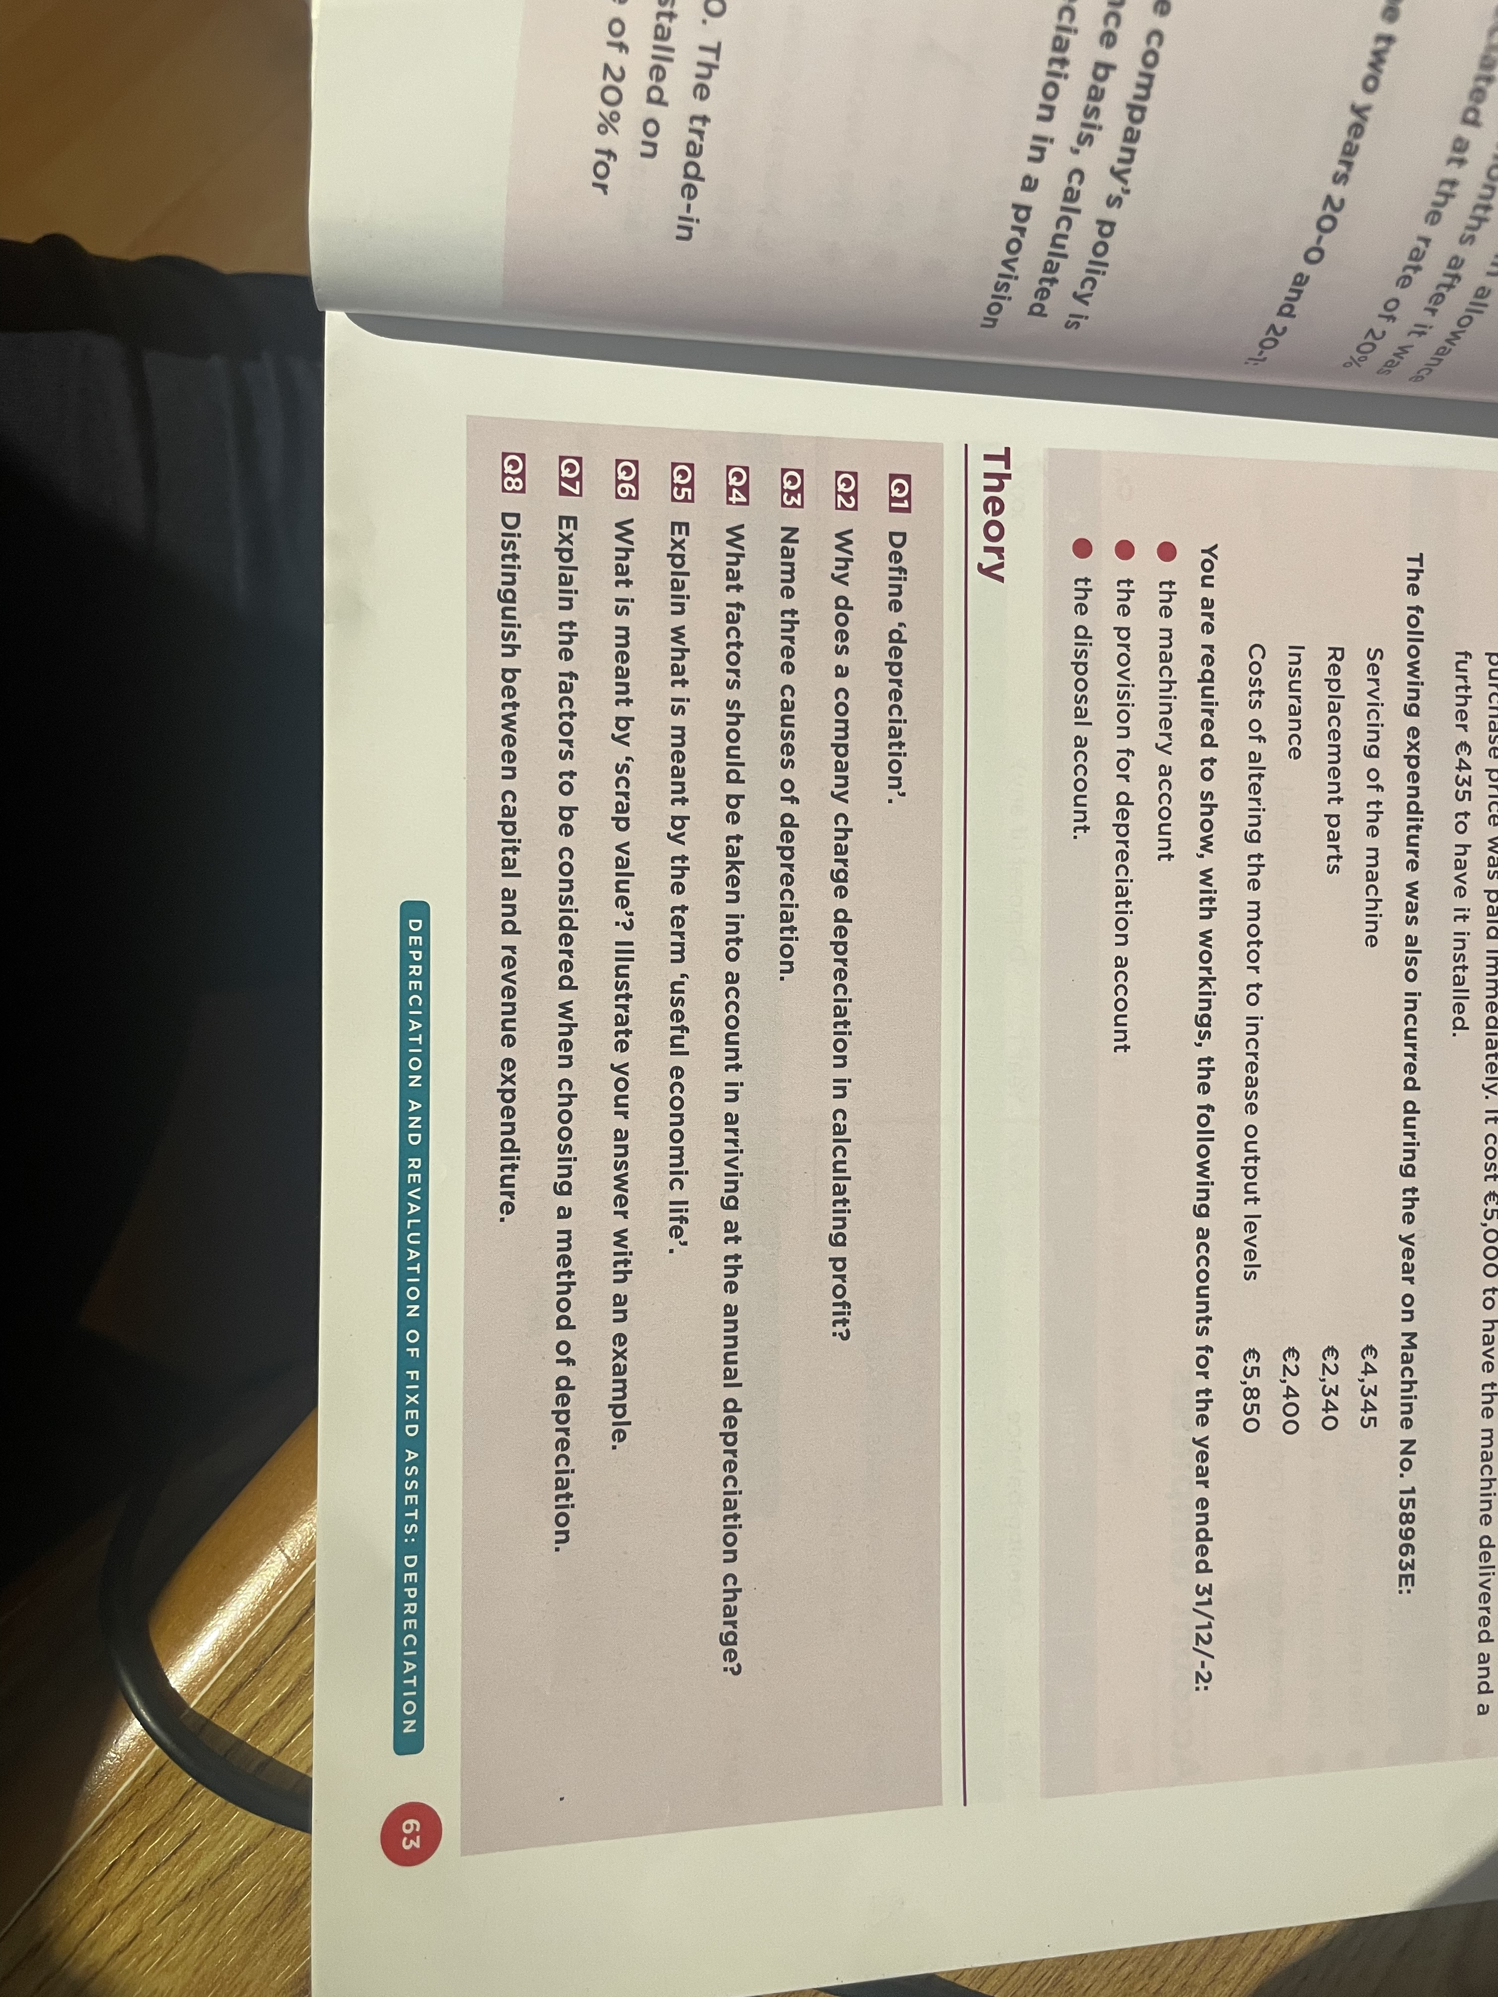
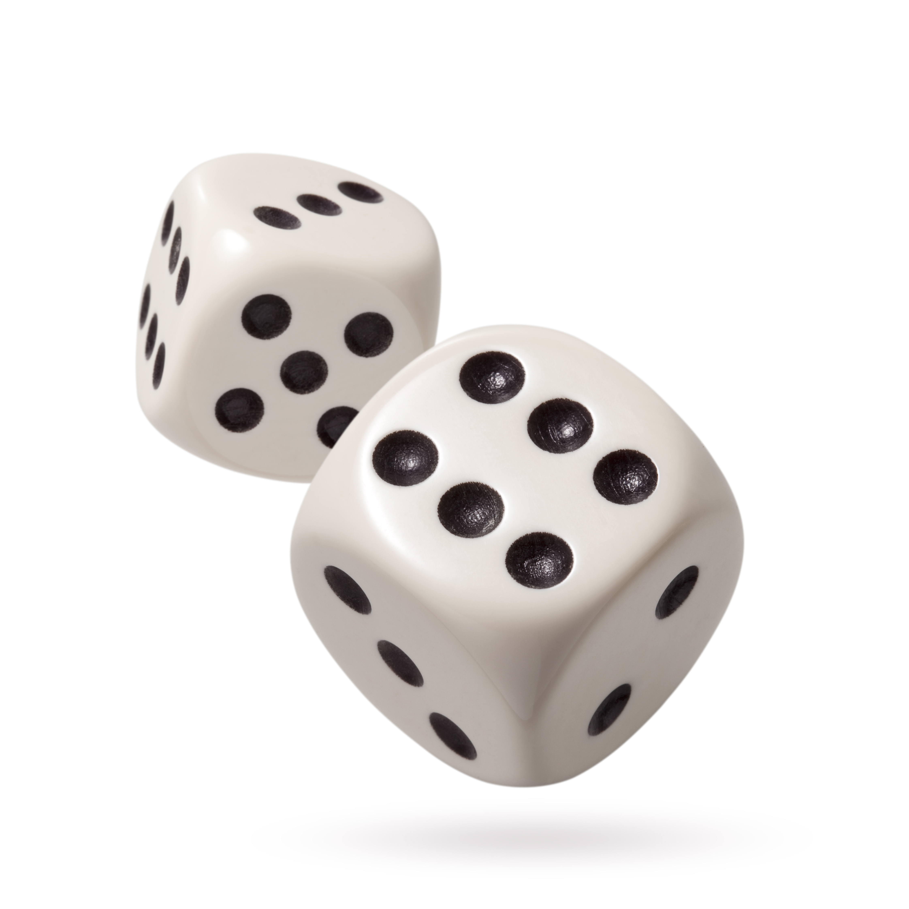
Retrieval Practice: Dice Roll
Questions on Depreciation:

Slide 20


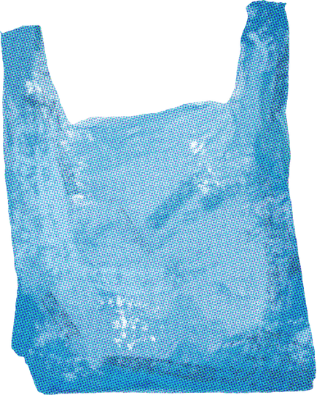
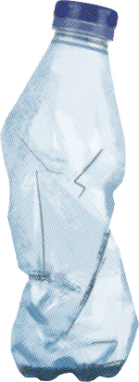

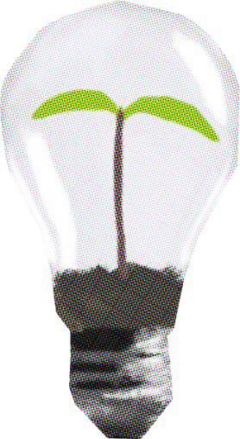







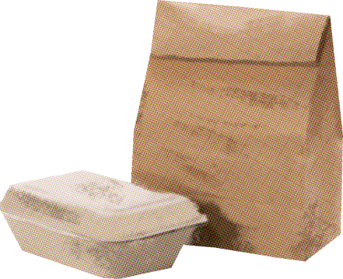
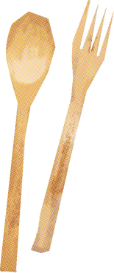








RESOURCE Page
  Use these icons and illustrations in your Canva Presentation. Happy designing! Don't forget to delete this page before presenting.
  set:nAE_Efq7uys
  set:nAE2go1Xrew

Slide 21





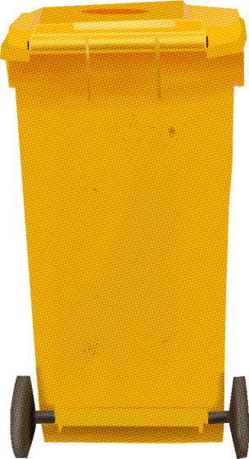

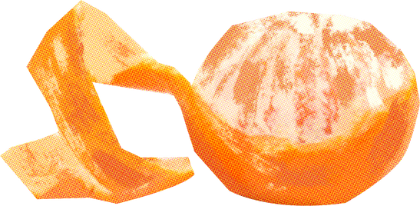
  Try this background for online class.
  *Please delete this section before downloading.

Slide 22

PRESS THESE KEYS while on Present mode!
B | for blur
D | for a drumroll
O | for bubbles
U | for unveil
C | for confetti
M | for mic drop
Q | for quiet
0-9 | any number for a timer

Slide 23
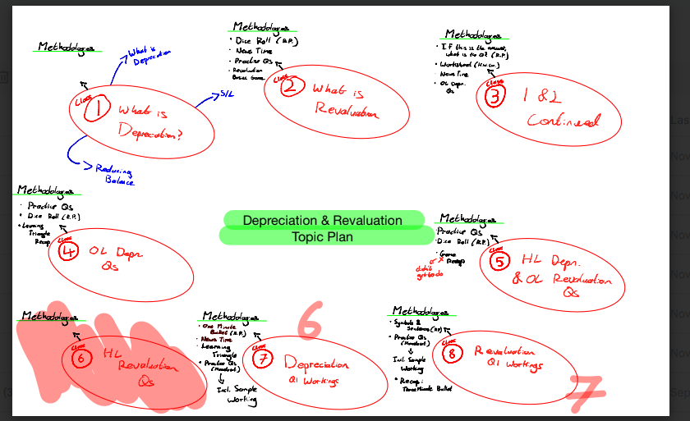
2023 Topic Plan

