Slide 1

Investment Income
Q1 Workings
5th Year Accounting | Mr. Regan

Slide 2
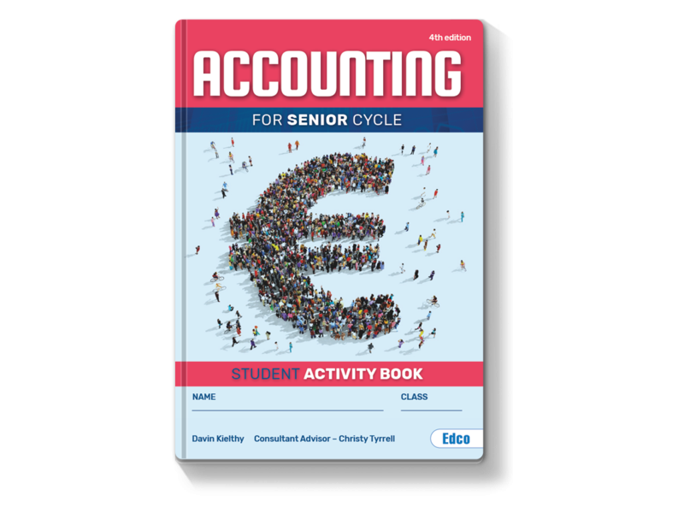
Workbook
Practice
Questions

Slide 3
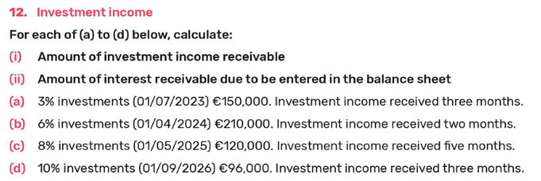
Workbook Practice Questions

Slide 4
Practice Q: (a.)

Slide 5
Practice Q: (b.)

Slide 6
Practice Q: (c.)

Slide 7
Practice Q: (d.)

Slide 8
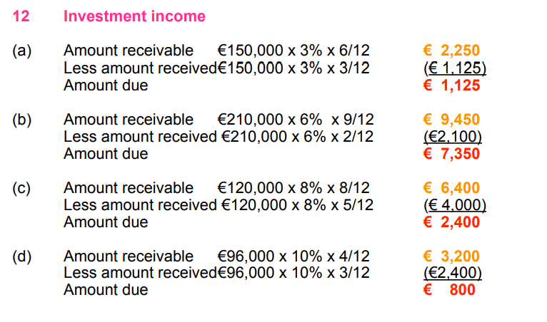
Solutions

